Slide 1

Exploratory Data Analysis
G2M Insight for Cab Investment Firm
By Chinmay Arvind
February 13, 2023

Slide 2
Agenda
EDA
EDA Summary
Recommendations

Slide 3
G2M Cab Investment opportunity - overview
XYZ is a private firm in US. Due to remarkable growth in the Cab Industry in last few years and multiple key players in the market, it is planning for an investment in Cab industry and as per their Go-to-Market(G2M) strategy they want to understand the market before taking final decision.
The objective of this presentation will be to see if some hypotheses generated from the data are feasible for supporting investment for G2M in the Cab industry.

Slide 4
Analysis
The data will be analysis will be a 3-fold process. It is as follows:
General data analysis – Looking at the general attributes of the data to try and see if any data can be appended, or joined to improve our hypotheses, and check to see if there are any glaringly obvious insights that can be made from just the aggregate data.
Trend data analysis – Looking at visualizations generated from the hypotheses and data to see if any particular insights can be drawn to better inform G2M about investment strategies.
Recommendations – Concisely putting together insights to help inform G2M about how to go about investing in the cab industry.

Slide 5
General Data Analysis overview
General information about the data:
4 csv files of data were analyzed, and the insights were drawn from them overall and individually (as shown later)
Total features (columns) in all datasets combined: 18
Total rows in all datasets combined (unmerged): 848,681
Timeframe of the dataset: 31/01/2016 to 31/12/2018
Total rows in the master dataset: 359,391

Slide 6
Hypotheses to be tested
1. Did the date of travel have an effect on trip costs?
2. Did the date of travel have an effect on price charged?
3. Did the city in which the trip occurred have any effect on the profit for the trip?
4. Did the gender of the customer have an effect on the profit for the trip?
5. Did the age of the customer have an effect on the price charged from the trip?
6. Did the city of the trip have an effect on the distance travelled on the trip?

Slide 7
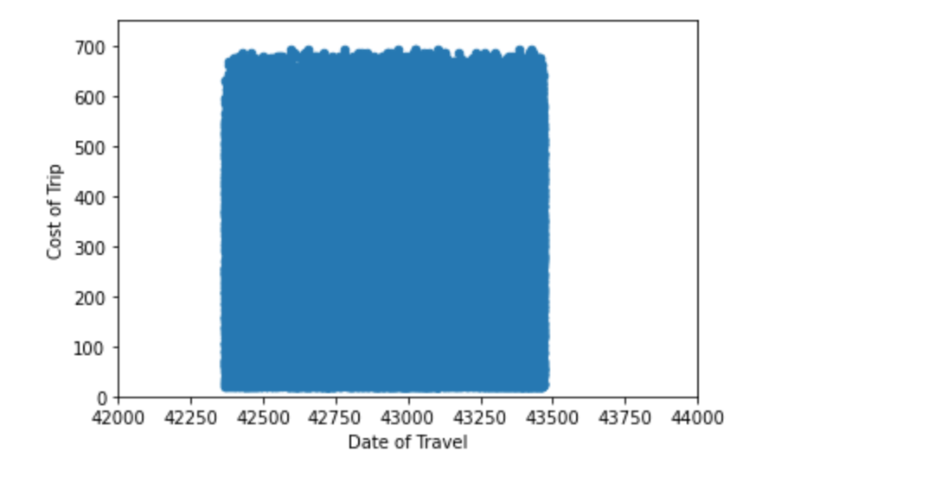
Hypothesis 1: G2M can be sure that the cost of trips to the cab companies during the given time frame will stay about the same

Slide 8
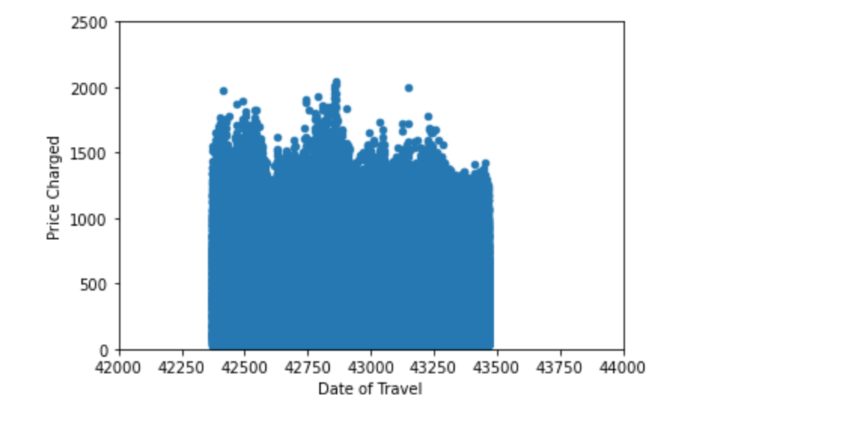
Hypothesis 2: G2M is advised to ensure that they invest more during the days where the price charged by cab companies spikes, or lower price to increase number of customers paying for the ride compared to competitor companies

Slide 9
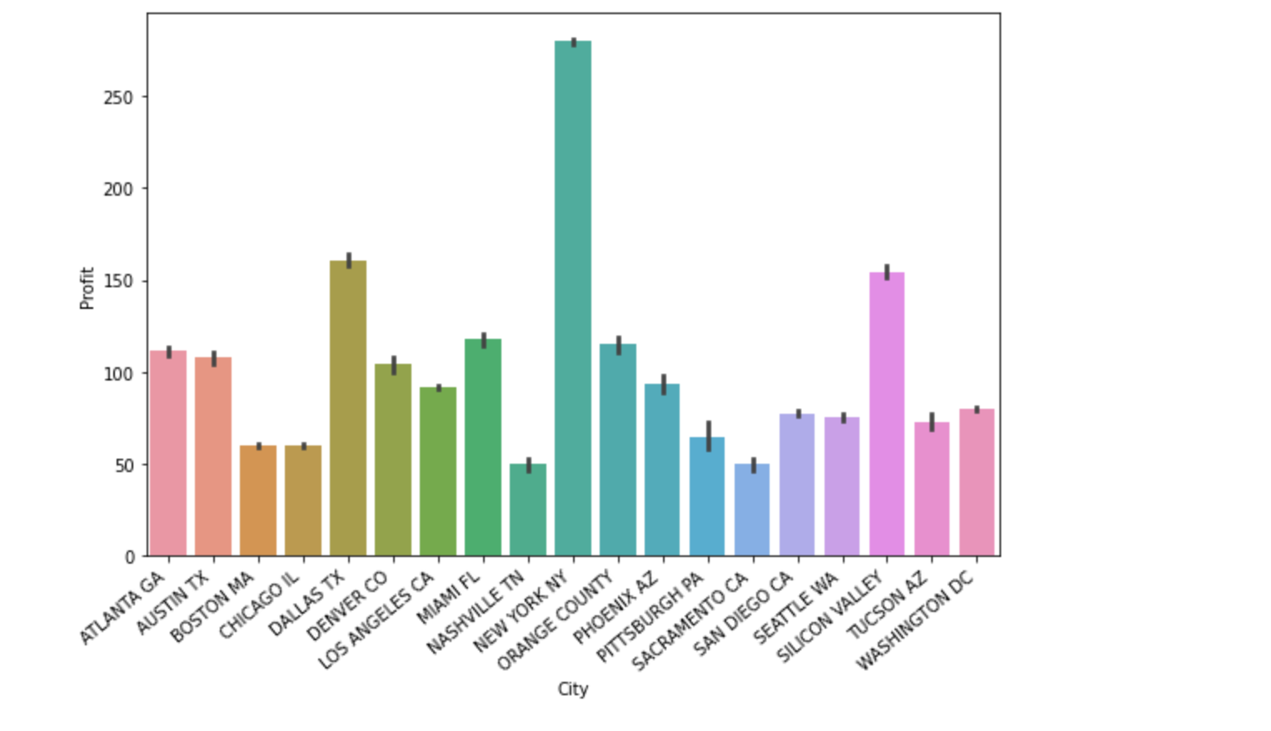
Hypothesis 3: Cities with higher profits would be better to start investing in a cab business for G2M

Slide 10
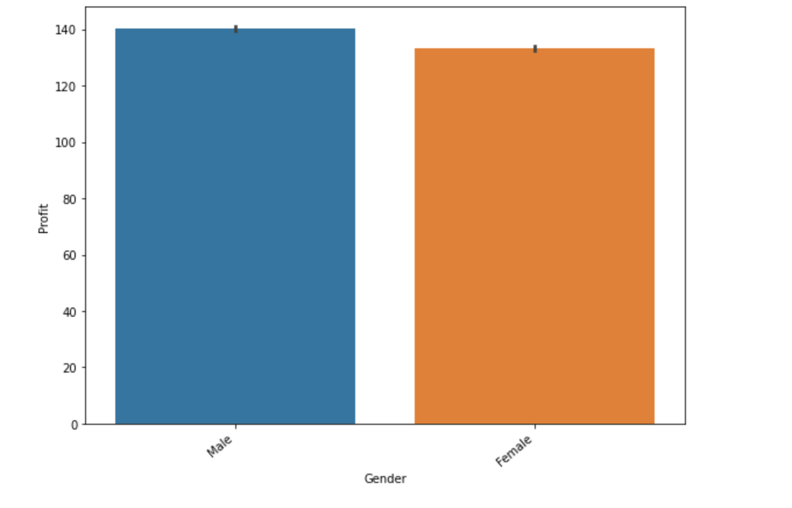
Hypothesis 4: Clear-cut gender demographic to focus on investing in to attract customers to cabs, and an area of improvement also possible for G2M

Slide 11
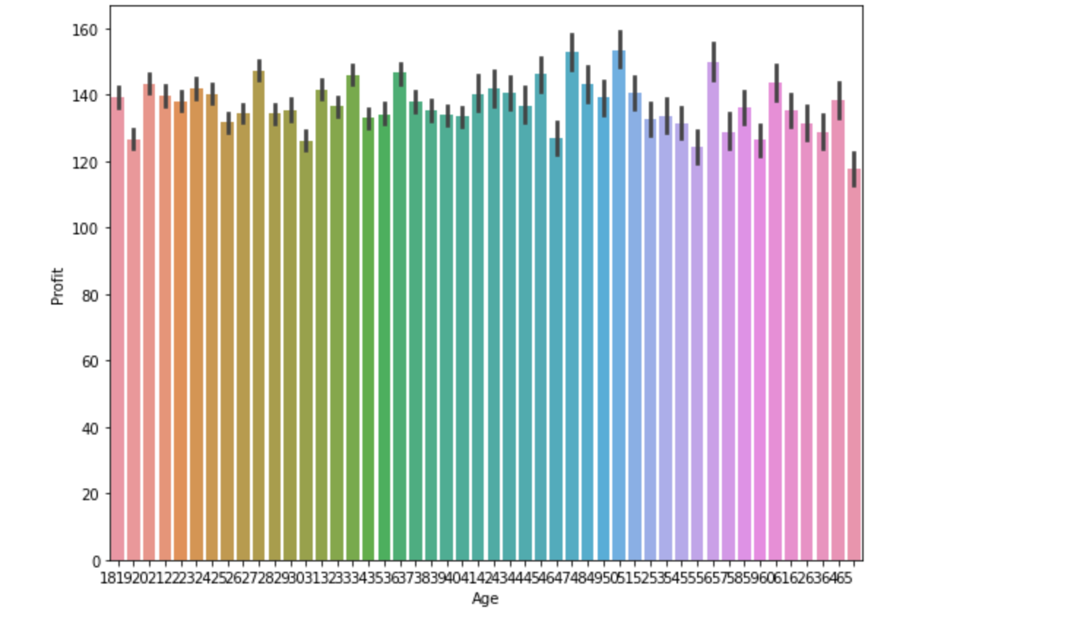
Hypothesis 5: Age of residents where in between middle-aged to early-old age can be a target demographic for investment in the cab industry for G2M

Slide 12
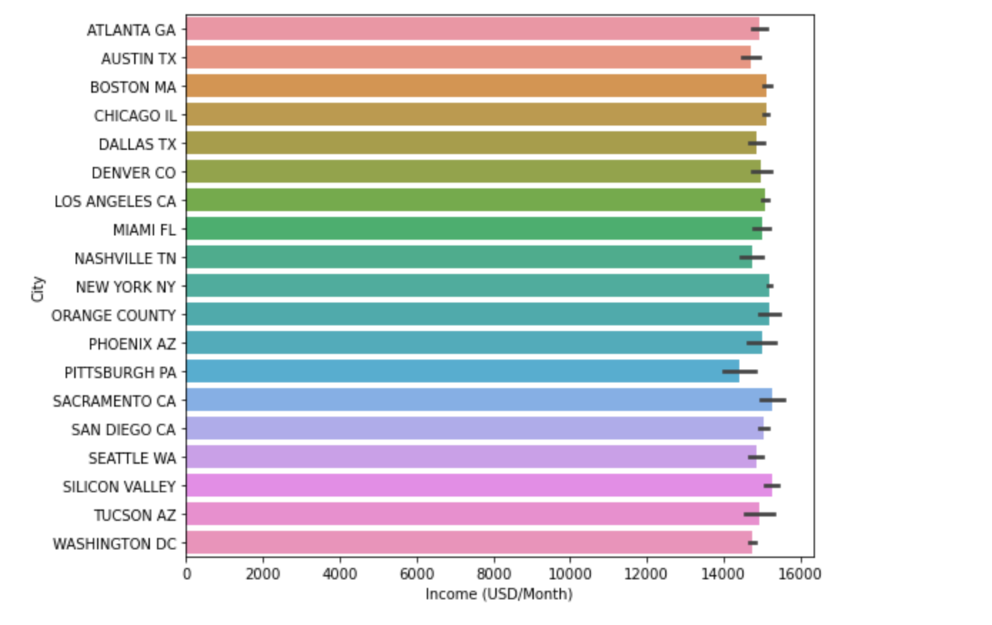
Hypothesis 6: Specific high-income cities can be used to invest more into their cab industries for G2M

Slide 13
Recommendations
We can suggest to G2M that the cost of the trip for the drivers that they will place in their cabs after investing the cab industry will stay about constant throughout the December timeframe given in the problem.
We can suggest to G2M that the price charged can be either hiked to the prices on days 42625, 42850, and 43150 for a few more days using different rates. Or we can suggest G2M to reduce prices to increase customers paying for cabs, and hence, eventually causing a boost in fares by out-lowering the prices compared to competitor companies’ prices.
It is better for GM2 to start their investment in a city like New York, where the profit margins are high which would make the investment project a success.
G2M should find cities where the population of males is higher to start off with higher sales, as can be seen from the data that male customers on average pay more to cabs, causing an increase in profit. Another suggestion would be to also simultaneously increase investment in Female customers being attracted to riding in cabs by either promising safety in rides, or employing women-drivers which would allow women to feel safer and ride via cabs more often.
G2M should find cities where average age of residents are between an age range of around 28 - 61 years of age as can be seen from the data that people in that age range tend to use cabs more, increasing the profit margin.
G2M should start their investment into the cab industry in cities like Sacramento, New York, and Orange County as people are more well-off and would be more willing to pay for cabs as compared to people from places like Atlanta, Austin, etc. who might not be as open to paying for cabs.

Slide 14
Questions?

Slide 15
Thank You

